Slide 1

Zeek Log Analysis Using ElasticSearch
Michael Garcia
Daniel Garza Professor: Dr. Gonzalo D. Parra

Slide 2
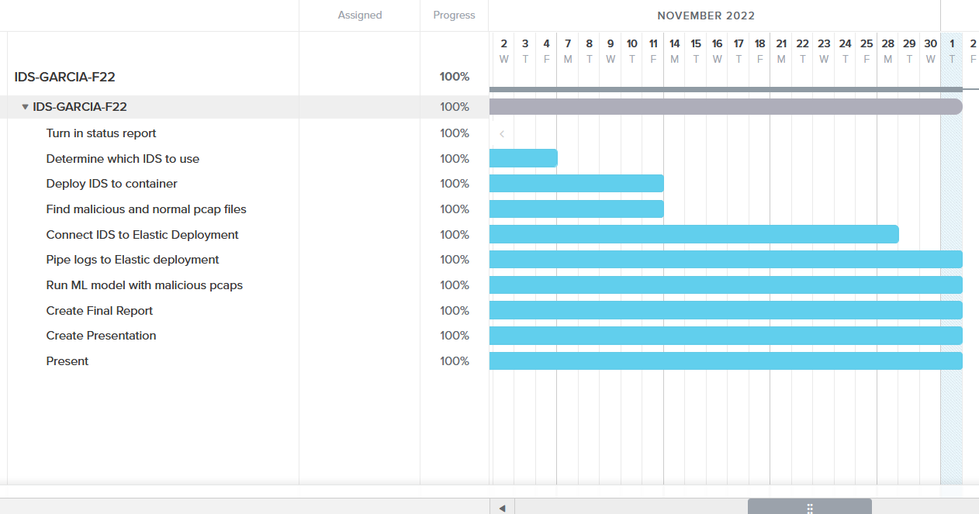
Gantt Chart

Slide 3
Software Overview
Zeek
Processed pcap files and split them into various logs
Filebeat
Used to process and deliver Zeek logs to ElasticSearch
ElasticSearch
Utilized to sort JSON-format Zeek logs based on file headers

Slide 4

Installing Zeek on Ubuntu
Update/Upgrade software
Install Zeek prerequisites - cmake make gcc g++ flex bison libpcap-dev libssl-dev python2-dev swig zlib1g-dev_
Add Zeek repositories to local repository
Install Zeek release key
Install zeek_lts

Slide 5
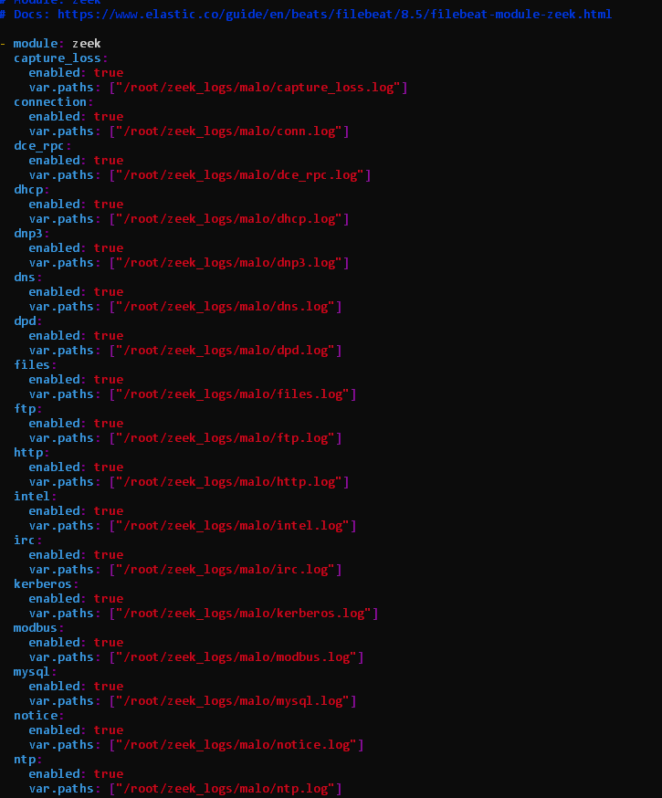
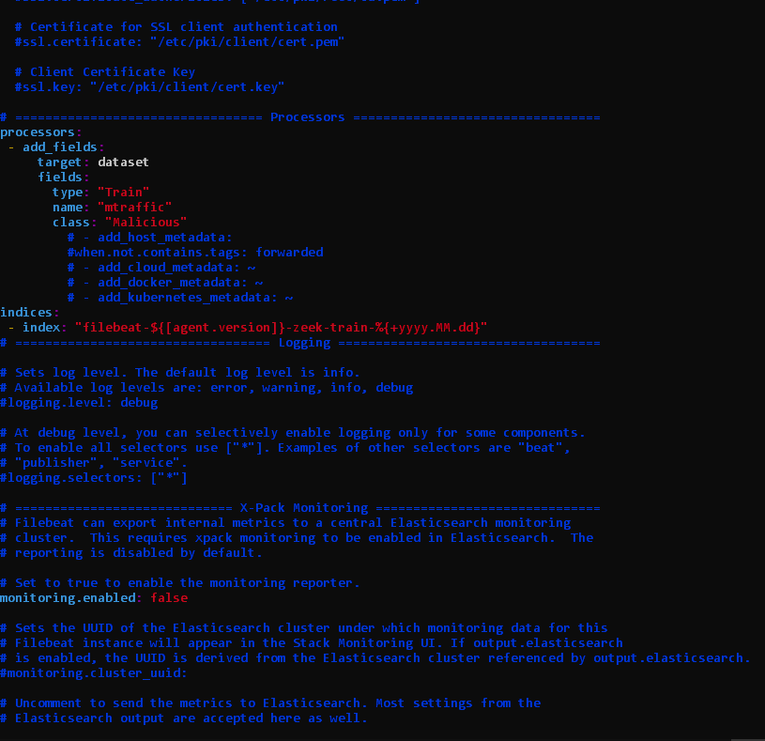

Slide 6

Difficulties & Resolution
Log files would not upload to ElasticSearch using Filebeat
Ingest pipelines were generated, and filebeat entry was shown in Index Management, but data was not found under “filebeat-*”
Recreated container completely
Reinstalled Filebeat
Rewrote filebeat.yml
Rewrote zeek.yml
Issue turned out to be a mismatch in versions
Filebeat was 8.5.2. Stack Management was 8.4.1.
Install of an older FIlebeat version solved issue
Unresolved ML issue on ElasticSearch

Slide 7
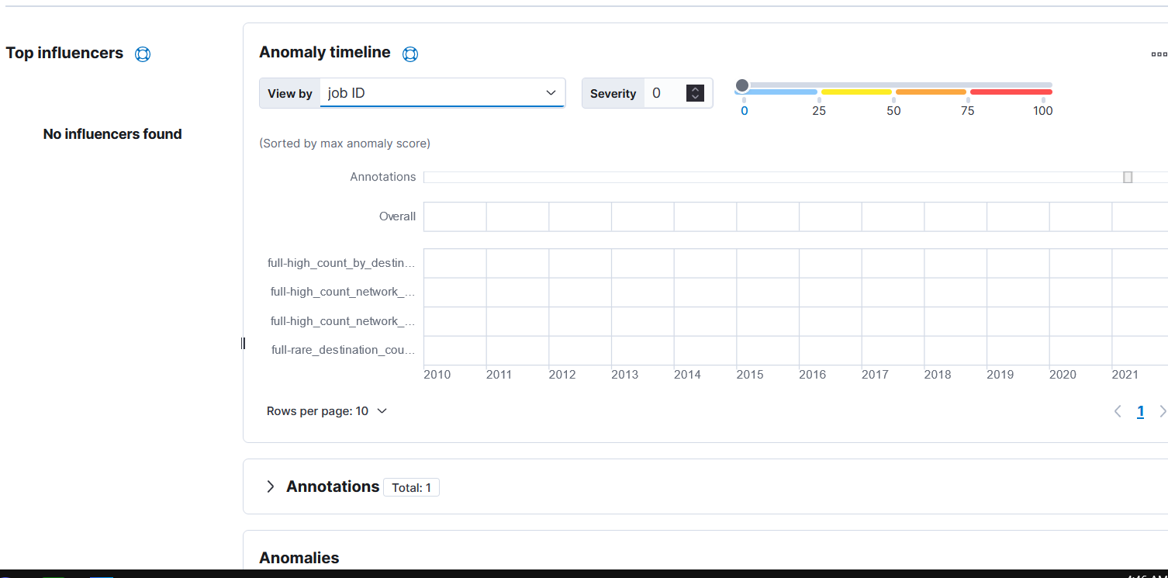
Machine Learning

Slide 8
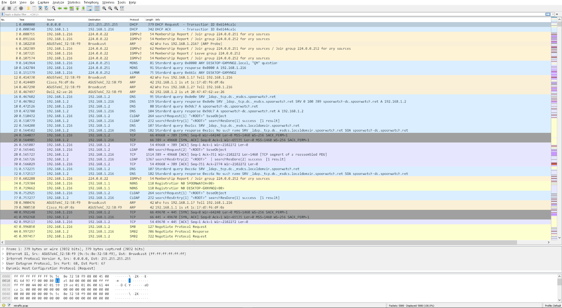
PCAP File
Malicious PCAP files were sourced from malware-traffic-analysis.net

Slide 9
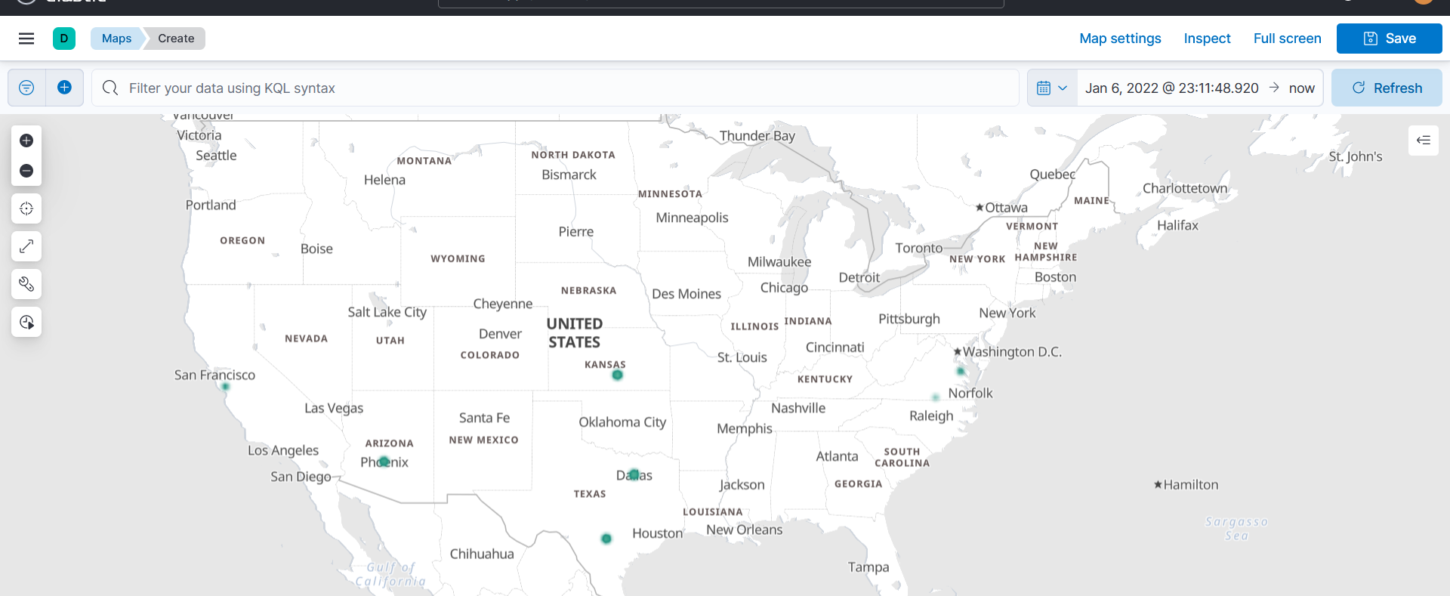
Data Views

Slide 10
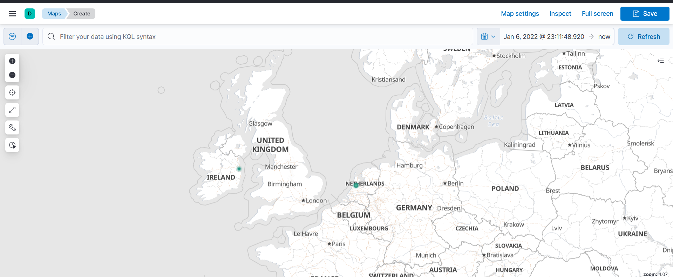

Slide 11
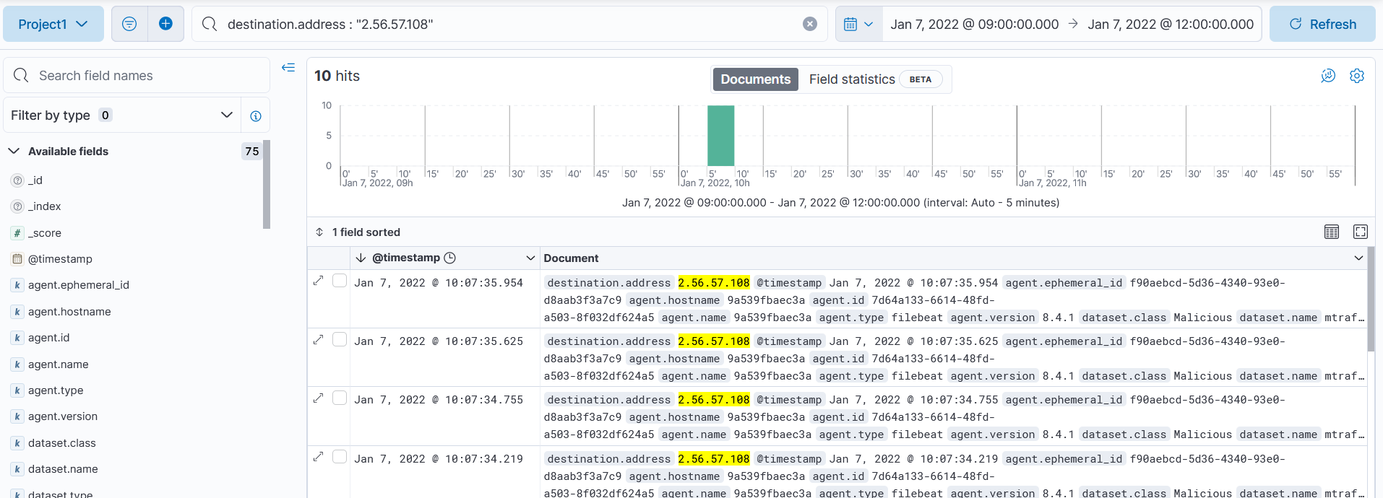

Slide 12
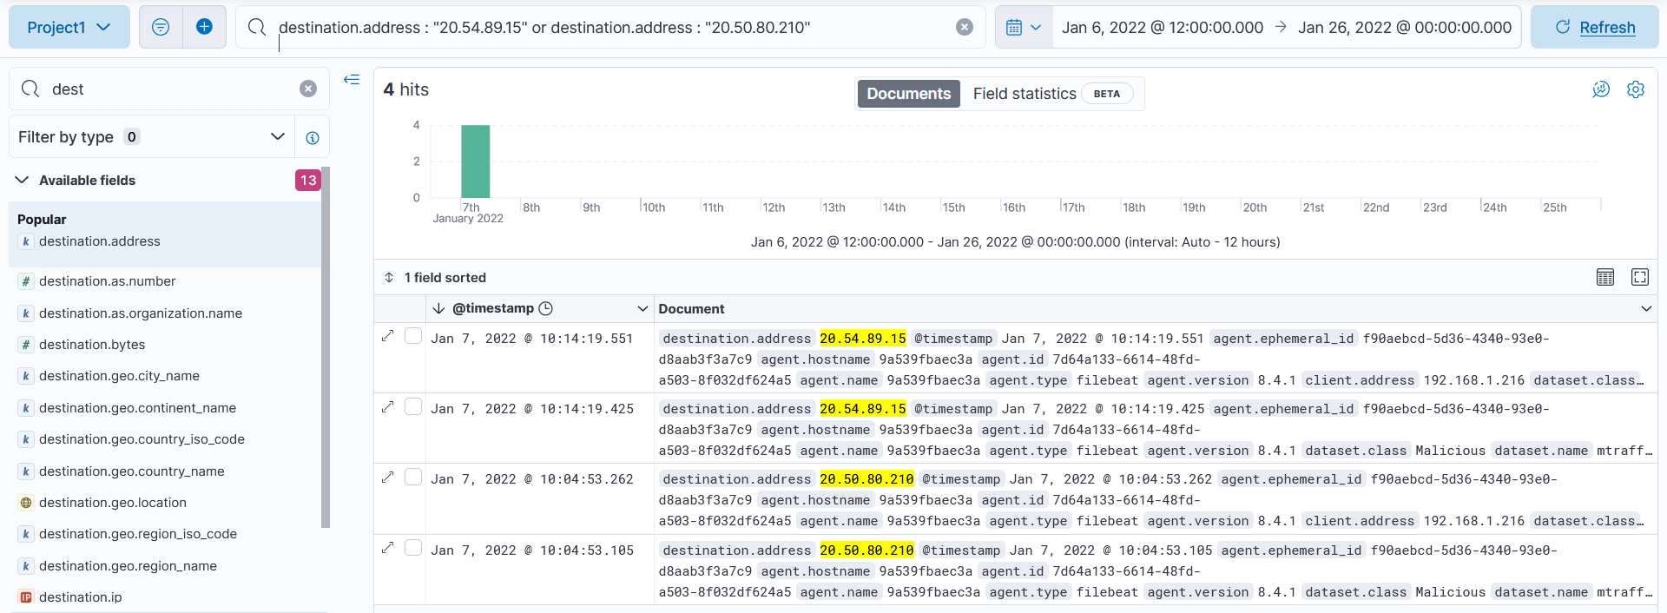

Slide 13

Potential Applications
ML can be a simple IDS with Zeek processing live network traffic
ML sample would need to be bigger to account for more anomalies
Useful for home or small business network monitoring
Minimal infrastructure would be needed, but require more resources as it scales
Account for having to pay for ElasticSearch resources
Paid network monitoring is feasible for bigger businesses
Ex. CrowdStrike Falcon Network Security Monitoring

Slide 14

What We Learned
Zeek is a great option for processing log files in JSON format
ML IDS is only as accurate as how much it’s trained, and consumes a lot of resources
ElasticSearch has a wide array of tools for visualizing malicious traffic

Slide 15
Resources
Eric. “Zeekurity Zen – Part VIII: How to Send Zeek Logs to Elastic.” Ericooi.com, 6 Sept. 2022, https://www.ericooi.com/zeekurity-zen-part-viii-how-to-send-zeek-logs-to-elastic/.
“Traffic-Analysis.net.” Malware, https://www.malware-traffic-analysis.net/.
Young, Michael. “Collecting and Analyzing Zeek Data with Elastic Security.” Elastic Blog, Elastic, 29 July 2021, https://www.elastic.co/blog/collecting-and-analyzing-zeek-data-with-elastic-security.

